Slide 1
CSCE 3600 Principles of Systems Programming Regular Expressions: sed and gawk
University of North Texas

Slide 2

The sed Stream Editor

Slide 3
The sed (Stream Editor)
sed is a non-interactive, line-oriented stream editor that processes one line at a time
Useful in text processing and especially performing in-place substitution
sed can make global substitutions of matched regex patterns with specific text
Example
How to change all occurrences of word "the" or "The" to uppercase "THE" in file called file1?
sed -r "s/(The|the)/THE/g" file1
Search for the string or Substitute every string
Replace all occurrences of pattern in pattern space

Slide 4
The sed Stream Editor
Usage:
sed -r "s/REGEX/TEXT/g" filename
Substitutes (replaces) occurrence(s) of REGEX with the given TEXT
If filename is omitted, reads from standard input
sed has other uses, but most can be emulated with substitutions
Resulting output to terminal
If wanted permanent changes, need redirect output to new file or make changes in-place using –i option
Example
Replaces all occurrences of 143 with 390 in file2.txt
sed -r "s/143/390/g" file2.txt

Slide 5
The sed Stream Editor
sed is line-oriented; processes input a line at a time
-r option makes regexes work better
Recognizes ( ) , [ ] , * , + the right way, etc.
s for substitute
g flag after last / asks for a global match (replace all)
Special characters must be escaped to match them literally
sed -r "s/http:\/\//https:\/\//g" urls.txt
sed can use delimiters besides / to make more readable
sed -r "s#http://#https://#g" urls.txt
Example
sed -r "s/([A-Za-z]+), ([A-Za-z]+)/\2 \1/g" names.txt

Slide 6
sed Usage
Edit files too large for interactive editing
Edit any size files where editing sequence is too complicated to type in interactive mode
Perform “multiple global” editing functions efficiently in one pass through the input
Edit multiples files automatically
Good tool for writing conversion programs
Good tool for in-pipe editing

Slide 7
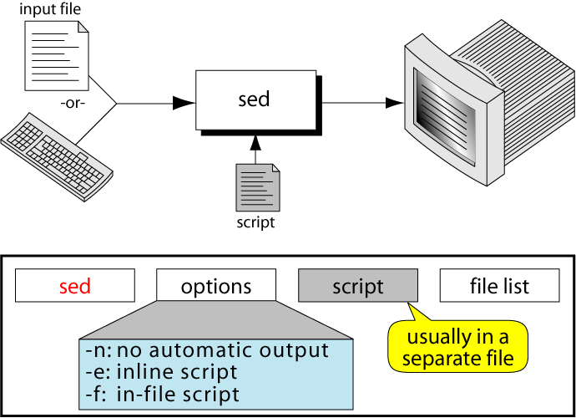
The sed Command
Syntax:
or
'command'

Slide 8
sed Syntax
sed [-n] [-e] ['command'] [file…]
sed [-n] [-f script] [file…]
Options
–n only print lines specified with print command (or 'p' flag of substitute ('s') command)
–f script next argument is filename containing editing commands
If first line of script is "#n", acts as if -n had been specified
–e command next argument is an editing command rather than filename, useful if multiple commands are specified

Slide 9
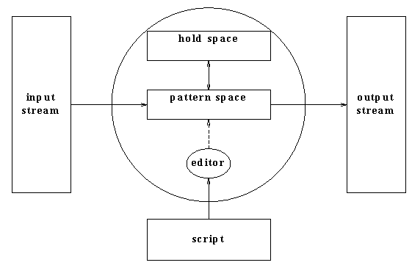
How Does sed Work?
sed reads line of input
Line of input is copied into a temporary buffer called pattern space
Editing commands are applied
Subsequent commands are applied to line in the pattern space, not the original input line
Once finished, line is sent to output (unless –n option was used)
Line is removed from pattern space
sed reads next line of input, until end of file
Note that input file is unchanged!
Notes:
https://www.youtube.com/watch?v=nXLnx8ncZyE

Slide 10
sed Scripts
A script is nothing more than a file of commands
Each command consists of an address and an action, where the address can be a regular expression or line number
address
action
command
address
action
address
action
address
action
address
action
script

Slide 11
sed Scripts
As each line of the input file is read, sed reads the first command of the script and checks the address against the current input line:
If there is a match, command executed
If there is no match, command ignored
sed then repeats this action for every command in script file
When it has reached the end of the script, sed outputs the current line (pattern space) unless the -n option has been set

Slide 12
Flow of Control
sed then reads the next line in the input file and restarts from the beginning of the script file
All commands in the script file are compared to, and potentially act on, all lines in the input file
stdin
sed
stdout
script
cmd 1
cmd 2
...
cmd n
print cmd
output
input
output
only without -n

Slide 13
sed Commands
sed commands have the general form
[address[, address]][!]command [arguments]
sed copies each input line into a pattern space
If address of the command matches line in pattern space, command is applied to that line
If command has no address, it is applied to each line as it enters pattern space
If a command changes the line in pattern space, subsequent commands operate on the modified line
When all commands have been read, the line in pattern space is written to standard output and a new line is read into pattern space

Slide 14
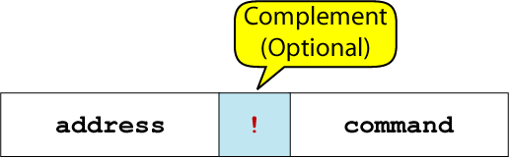
Addressing
Address determines which lines in the input file are to be processed by the command(s)
Either a line number or a pattern, enclosed in slashes / … /
If no address is specified, then command is applied to each input line
Most commands will accept two addresses
If only one address is given, command operates only on that line
If two comma separated addresses are given, then command operates on a range of lines between the first and second address, inclusively
The ! operator can be used to negate an address
Command applied to all lines that do NOT match address

Slide 15
Commands
Command is a single letter
Example:
Deletion: d
[address1][,address2]d
Delete the addressed line(s) from the pattern space
Line(s) not passed to standard output
A new line of input is read and editing resumes with the first command of the script

Slide 16
Delete Address-Command Examples
d deletes all lines
6d deletes line 6
/^$/d deletes all blank lines
1,10d deletes lines 1 through 10
1,/^$/d deletes from line 1 through the first blank line
/^$/,$d deletes from first blank line through last line of file
/^$/,10d deletes from first blank line through line 10
/^ya*y/,/[0-9]$/d deletes from first line that begins with yay, yaay, yaaay, etc. through first line that ends with a digit

Slide 17
Delete Command (D) Example
Remove Part-time data from “tuition.data” file
cat tuition.data
Part-time 1003.99
Two-thirds-time 1506.49
Full-time 2012.29
sed –e '/^Part-time/d' tuition.data
Two-thirds-time 1506.49
Full-time 2012.29
Input data
Output after applying delete command

Slide 18
Multiple Commands
Braces { } used to apply multiple commands to an address
[address][,address]{
command1
command2
command3
}
The opening brace { must be the last character on a line
The closing brace } must be on a line by itself
No spaces following the braces
Alternatively, use “;” after each command:
[address][,address]{command1; command2; command3; }
Or:
'[address][,address]command1; command2; command3'

Slide 19
sed Commands
sed contains many editing commands, though only a few are mentioned here
s substitute
a append
i insert
c change
d delete
p print
r read
w write
y transform
= display line number
N append next line to current one
q quit

Slide 20
Print
Print command (p) used to force pattern space to be output, useful if -n option has been specified
Syntax:
[address1[,address2]]p
Note: if -n or #n option has not been specified, p will cause the line to be output twice!
Examples:
1,5p will display lines 1 through 5
/^$/,$p will display lines from first blank line through last line of file

Slide 21
Substitute
Syntax:
[address(es)]s/pattern/replacement/[flags]
pattern : search pattern
replacement : replacement string for pattern
flags : optionally any of the following
n a number from 1 to 512 indicating which occurrence of pattern should be replaced
g global, replace all occurrences of pattern in pattern space
p print contents of pattern space

Slide 22
Substitute Examples
s/Puff Daddy/P. Diddy/
Substitute P. Diddy for the first occurrence of Puff Daddy in pattern space
s/Four/Five/2
Substitutes Five for the second occurrence of Four in the pattern space (i.e., each line)
s/paper/plastic/p
Substitutes plastic for the first occurrence of paper and outputs (prints) pattern space

Slide 23
Replacement Patterns
Substitute can use several special characters in the replacement string
& replaced by entire string matched in regular expression for pattern
\n replaced by nth substring (or sub-expression) previously specified using "\(" and "\)”
\ used to escape the ampersand (&) and the backslash (\)
/^ya*y/,/[0-9]$/d deletes from first line that begins with yay, yaay, yaaay, etc. through first line that ends with a digit

Slide 24
Replacement Pattern Examples
"the UNIX operating system …"
s/.NI./wonderful &/
--> "the wonderful UNIX operating system …"
"unix is fun"
sed 's/\([[:alpha:]]\)\([^ \n]*\)/\2\1ay/g'
--> "nixuay siay unfay”
cat file3
first:second
one:two
sed 's/\(.*\):\(.*\)/\2:\1/' file3
second:first
two:one
Inserts ay and swaps position

Slide 25
Append, Insert, and Change
Syntax for these commands is little strange because they must be specified on multiple lines
Append
[address]a\
text
Insert
[address]i\
text
Change
[address(es)]c\
text
Append (a) and Insert (i) for single lines only, not range

Slide 26
Append Command (A) Example
cat tuition.append.sed
a \
--------------------------
cat tuition.data
Part-time 1003.99
Two-thirds-time 1506.49
Full-time 2012.29
sed -f tuition.append.sed tuition.data
Part-time 1003.99
--------------------------
Two-thirds-time 1506.49
--------------------------
Full-time 2012.29
--------------------------
sed script to append
dashed line after
each input line
Input data
Output after applying
the append command

Slide 27
Insert Command (I) Example
cat tuition.insert.sed
1 i\
Tuition List\
cat tuition.data
Part-time 1003.99
Two-thirds-time 1506.49
Full-time 2012.29
sed -f tuition.insert.sed tuition.data
Tuition List
Part-time 1003.99
Two-thirds-time 1506.49
Full-time 2012.29
sed script to insert “Tuition List” as report title before line 1
Input data
Output after applying
the insert command

Slide 28
Change Command (C) Example
cat tuition.change.sed
1 c\
Part-time 1100.00
cat tuition.data
Part-time 1003.99
Two-thirds-time 1506.49
Full-time 2012.29
sed -f tuition.change.sed tuition.data
Part-time 1100.00
Two-thirds-time 1506.49
Full-time 2012.29
sed script to change
tuition cost from
1003.99 to 1100.00
Input data
Output after applying
the change command

Slide 29
Complement (!) Operator
If an address is followed by exclamation point (!), associated command is applied to all lines that don’t match address or address range
Examples:
/black/!s/cow/horse/
substitute horse for cow on all lines except those that contained black
1,5!d delete all lines except 1 through 5
Print lines that do not contain “obsolete”
sed –e '/obsolete/!p' input-file
"The brown cow" --> "The brown horse"
"The black cow" --> "The black cow"

Slide 30
Read and Write File Commands
Syntax: r filename
Queue contents of filename to be read and inserted into output stream at end of current cycle, or when next input line is read
If filename cannot be read, treated as if were an empty file, without any error indication
Syntax: w filename
Write the pattern space to filename
The filename will be created (or truncated) before the first input line is read
All w commands which refer to the same filename are output through the same FILE stream

Slide 31
Read and Write File Commands
cat tmp
one two three
one three five
two four six
sed 'r tmp'
My first line of input ---> not read until the first line is taken from the input
My first line of input
one two three
one three five
two four six
My next line
My next line^D
sed 'w tmp1'
hello 1
hello 1
hello 2
hello 2
hello 3
hello 3^D
cat tmp1
hello 1
hello 2
hello 3

Slide 32
Line Number
Line number command (=) writes the current line number before each matched/output line
Examples:
sed -e '/Two-thirds-time/=' tuition.data
sed -e '/^[0-9][0-9]/=' inventory
sed '=' tmp1
1
hello1
2
hello2
3
hello3
sed -n '=' tmp1
1
2
3

Slide 33
Transform
Transform command (y) operates like tr, doing a one-to-one or character-to-character replacement
Accepts zero, one or two addresses
[address[,address]]y/abc/xyz/
Every a within the specified address(es) is transformed to an x, b to y and c to z
Examples
y/abcdefghijklmnopqrstuvwxyz/ABCDEFGHIJKLMNOPQRSTUVWXYZ/
Changes all lower case characters on addressed line to upper case
sed –e '1,10y/abcd/wxyz/' datafile
Must have same number of characters

Slide 34
Quit
Syntax: [addr]q
Quit (exit sed) when addr is encountered
It takes at most a single line address
Once a line matching the address is reached, script will be terminated
Can be used to save time when you only want to process some portion of the beginning of a file
Example
To print the first 100 lines of a file (like head)
sed '100q' filename
sed will, by default, send the first 100 lines of filename to standard output and then quit processing

Slide 35
The gawk Programming Language

Slide 36
The gawk Programming Language
A scripting language used for manipulating data and generating reports
Geared towards working with delimited fields on a line-by-line basis
Summary of gawk operations
Scans a file line-by-line
Splits each input line into fields
Compares each input line and fields to the specified pattern
Performs the requested action(s) on lines matching the specified pattern

Slide 37
Structure of a gawk Program
A gawk program consists of:
An optional BEGIN segment
For processing to execute prior to reading input
Pattern – Action pairs
Processing for input data
For each pattern matched, the corresponding action is taken
An optional END segment
Processing after end of input data
BEGIN {action}
pattern {action}
pattern {action}
.
.
.
pattern { action}
END {action}

Slide 38
Running a gawk Program
There are several ways to run a gawk program
gawk 'program' input_file(s)
Program and input files are provided as command-line arguments
gawk 'program'
Program is a command-line argument
Input is taken from standard input
gawk -f program_file input_files
Program is read from a file

Slide 39
Patterns and Actions
Search a set of files for patterns
Perform specified actions upon lines or fields that contain instances of patterns
Does not alter input files
Process one input line at a time
This is similar to sed

Slide 40
Pattern-Action Structure
Every program statement has to have a pattern or an action or both
Default pattern is to match all lines
Default action is to print current record
Patterns are simply listed; actions are enclosed in { }
Some actions can be similar to C code
gawk scans a sequence of input lines, or records, one by one, searching for lines that match the pattern
Meaning of match depends on the pattern

Slide 41
Patterns
Selector that determines whether action is to be executed
Pattern can be:
Special token BEGIN or END
Regular expression (enclosed with / /)
Relational or string match expression
! negates the match
Arbitrary combination of the above using && and/or ||
/UNT/ matches if the string “UNT” is in the record
x > 0 matches if the condition is true
/UNT/ && (name == "UNIX Tools")

Slide 42
BEGIN and END Patterns
BEGIN and END provide a way to gain control before and after processing, for initialization, and wrap-up
BEGIN
Actions are performed before first input line is read
END
Actions are done after the last input line has been processed.

Slide 43
Actions
Action may include a list of one or more C like statements, as well as arithmetic and string expressions and assignments and multiple output streams
Action performed on every line that matches pattern
If pattern not provided, action performed on every input line
If action not provided, all matching lines sent to standard output
Since patterns and actions are optional, actions must be enclosed in braces to distinguish them from pattern

Slide 44
Introductory Example
ls | gawk ' BEGIN { print "List of html files:" } /\.html$/ { print } END { print "There you go!" } '
List of html files: index.html as1.html as2.html There you go!

Slide 45
Variables
gawk scripts can define and use variables
BEGIN { sum = 0 }
{ sum++ }
END { print sum }
Some variables are predefined

Slide 46
Basic gawk Terminology
gawk supports two types of buffers
Field
A unit of data in a line separated from other fields by the field separator
Record
A collection of fields in a line (file made up of records)
Default field separator is whitespace
Namespace for fields in current record: $1, $2, etc.
The $0 variable contains the entire record (i.e., line)
Example
Given line of input: "This class is fun!"
$1 = "This", $2 = "class", etc.

Slide 47
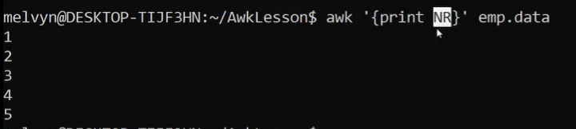
Records
Default record separator is newline
By default, gawk processes its input one line at a time
Could be any other regular expression
RS: record separator
Can be changed in BEGIN action
NR is the variable whose value is the number of the current record

Slide 48
Fields
Each input line is split into fields
FS: field separator
Default is whitespace (1 or more spaces or tabs)
gawk -Fc option sets FS to the character c
Can also be changed in BEGIN
$0 is the entire line
$1 is the first field, $2 is the second field, ….
Only fields begin with $, variables do not

Slide 49
Some gawk System Variables
gawk supports number of system variables
FS Field separator (default = space)
RS Record separator (default = \n)
NF Number of fields in current record
NR Number of the current record
OFS Output field separator (default = space)
ORS Output record separator (default = \n)
FILENAME Current filename
ARGC/ARGV Get arguments from command line

Slide 50
Simple Output from gawk
Printing every line
If action has no pattern, action is performed to all input lines
{ print } prints all input lines to standard out
{ print $0 } will do the same thing
Printing certain fields
Multiple items can be printed on the same output line with a single print statement
{ print $1, $3 }
Expressions separated by a comma are, by default, separated by a single space when printed (OFS)

Slide 51
More Output from gawk
NF, the Number of Fields
Any valid expression can be used after a $ to indicate the contents of a particular field
One built-in expression is NF, or Number of Fields
{ print NF, $1, $NF } will print number of fields, first field, and last field in the current record
{ print $(NF-2) } prints the third to last field
Computing and printing
You can also do computations on the field values and include the results in your output
{ print $1, $2 * $3 }

Slide 52
More Output from gawk
Printing line numbers
The built-in variable NR can be used to print line numbers
{ print NR, $0 } prints each line prefixed with its line number
Putting text in the output
You can also add other text to the output besides what is in the current record
{ print "total pay for", $1, "is", $2 * $3 }
Note that the inserted text needs to be surrounded by double quotes

Slide 53
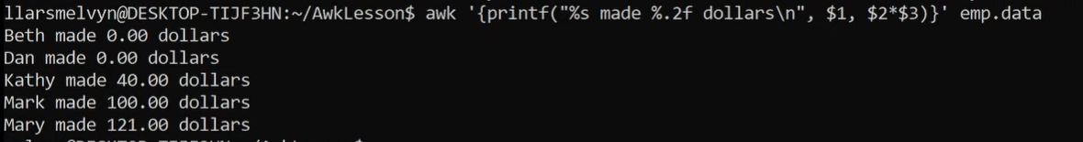
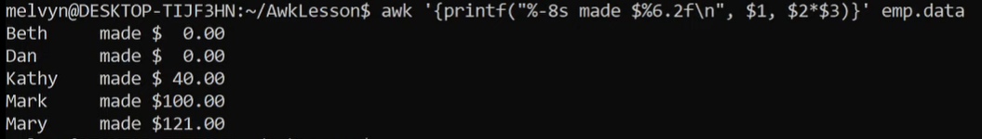
Formatted Output from gawk
Lining up fields
Like C, gawk has a printf function for producing formatted output
printf has the form printf( format, val1, val2, val3, … )
{ printf("total pay for %s is $%.2f\n", $1, $2 * $3) }
When using printf, formatting is under your control so no automatic spaces or newlines are provided by gawk
You have to insert them yourself.
{ printf("%-8s %6.2f\n", $1, $2 * $3 ) }

Slide 54
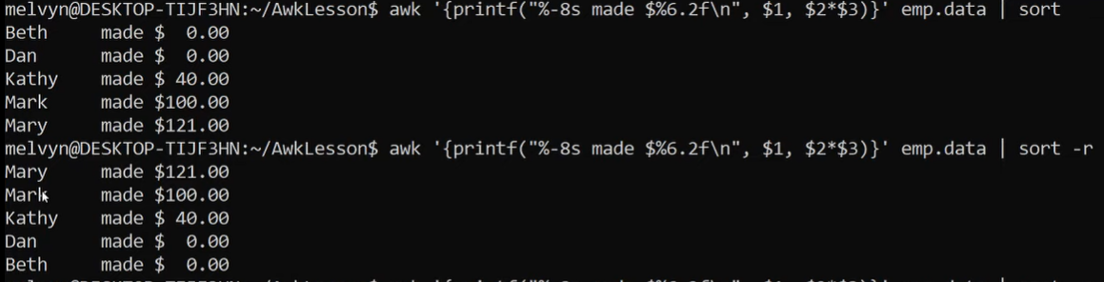
Formatted Output from gawk
Sorting output
{ printf("total pay for %s is $%.2f\n", $1, $2 * $3) }
Sorting and then using grep

Slide 55
Selection
gawk patterns are good for selecting specific lines from the input for further processing
Selection by comparison
$2 >= 5 { print }
Selection by computation
$2 * $3 > 50 { printf("%6.2f for %s\n", $2 * $3, $1) }
Selection by text content
$1 == "UNT"
$2 ~ /UNT/
Combinations of patterns
$2 >= 4 || $3 >= 20
Selection by line number
NR >= 10 && NR <= 20

Slide 56
Arithmetic and Variables
gawk variables take on numeric (floating point) or string values according to context
User-defined variables are unadorned (i.e., they do not need to be declared)
By default, user-defined variables are initialized to the null string which has numerical value 0

Slide 57
Computing with gawk
Counting is easy to do with gawk
$3 > 15 { emp = emp + 1}
END { print emp, "employees worked more than 15 hrs"}
Computing sums and averages is also simple
{ pay = pay + $2 * $3 }
END { print NR, "employees"
print "total pay is", pay
print "average pay is", pay/NR
}

Slide 58
Handling Text
One major advantage of gawk is its ability to handle strings as easily as many languages handle numbers
gawk variables can hold strings of characters as well as numbers, and gawk conveniently translates back and forth as needed
This program finds the employee who is paid the most per hour:
# Fields: employee, payrate $2 > maxrate { maxrate = $2; maxemp = $1 }
END { print "highest hourly rate:",
maxrate, "for", maxemp }

Slide 59
String Manipulation
String Concatenation
New strings can be created by combining old ones
{ names = names $1 " " }
END { print names }
Printing the Last Input Line
Although NR retains its value after the last input line has been read, $0 does not
{ last = $0 }
END { print last }

Slide 60
Built-In Functions
gawk contains a number of built-in functions: length is one of them
Counting lines, words, and characters using length (similar to wc)
{ nc = nc + length($0) + 1
nw = nw + NF
}
END { print NR, "lines,", nw, "words,", nc,
"characters" }
substr(s, m, n) produces substring of s that begins at position m and is at most n characters long

Slide 61
Control Flow Statements
gawk provides several control flow statements for making decisions and writing loops
If-Then-Else
$2 > 6 { n = n + 1; pay = pay + $2 * $3 }
END { if (n > 0)
print n, "employees, total pay is", pay, "average pay is", pay/n
else
print "no employees are paid more than $6/hour"
}

Slide 62
Loop Control
While
# interest1 - compute compound interest
# input: amount, rate, years
# output: compound value at end of each year
{ i = 1
while (i <= $3) {
printf("\t%.2f\n", $1 * (1 + $2) ^ i)
i = i + 1
}
}
Do-While Loops
do {
statement1
}
while (expression)

Slide 63
for Statements
For
# interest2 - compute compound interest
# input: amount, rate, years
# output: compound value at end of each year
{ for (i = 1; i <= $3; i = i + 1)
printf("\t%.2f\n", $1 * (1 + $2) ^ i)
}

Slide 64
Arrays
Array elements are not declared
Array subscripts can have any value:
Numbers
Strings (associative arrays)
Examples
arr[3]="value"
grade["Smith"]=40.3

Slide 65
Array Example
# reverse - print input in reverse order by line
{ line[NR] = $0 } # remember each line
END { for (i=NR; (i > 0); i=i-1) { print line[i] } }
Use for loop to read associative array
for (v in array) { … }
Assigns to v each subscript of array (unordered)
Element is array[v]

Slide 66
Operators
= assignment operator
Sets a variable equal to a value or string
== equality operator
Returns TRUE if both sides are equal
!= inverse equality operator
&& logical AND
|| logical OR
! logical NOT
<, >, <=, >= relational operators
+, -, /, *, %, ^
~ and !~ are used to perform regex comparisons, as in
exp ~ /regexp/

Slide 67
Built-In Functions
Arithmetic
sin, cos, atan, exp, int, log, rand, sqrt
String
length, substr, split
Output
print, printf
Special
system - executes a Unix/Linux command
system("clear") to clear the screen
Note double quotes around the Unix command
exit - stop reading input and go immediately to the END pattern-action pair if it exists, otherwise exit the script

Slide 68
gawk Examples
Records and fields
gawk '{print NR, $0}' emp1
Space as field separator
gawk '{print NR, $1, $2, $5}' emp1
Colon as field separator
gawk -F: '/Jones/{print $1, $2}' emp2
Match input record
gawk -F: '/00$/' emp2
Explicit match
gawk '$5 ~ /\.[7-9]+/' emp3
Matching with regexes
gawk '$2 !~ /E/{print $1, $2}' emp3
gawk '/^[ns]/{print $1}' emp3

